Slide 1
Convolutional Neural Network and its Variants

Slide 2
Outline
Applications
Multilayer Perceptron
Shallow vs Deep
Building Blocks of CNN
Challenges

Slide 3

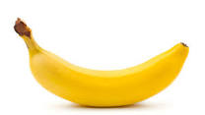

Slide 4



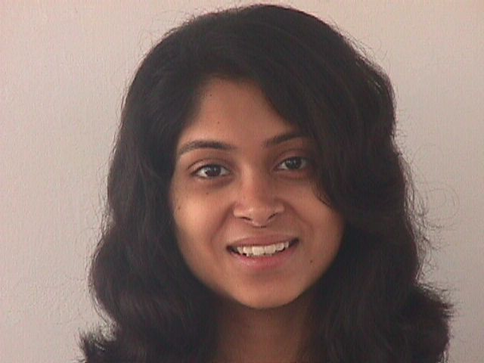
Face Recognition

Slide 5
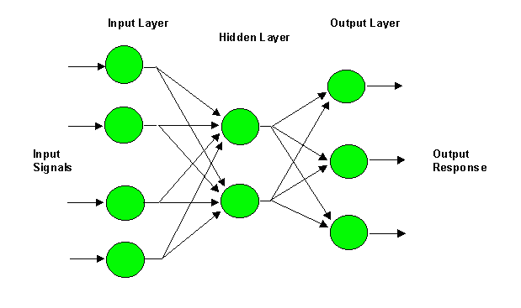
Multilayer Perceptron (MLP)
i
W_{ji}
j
W_{kj}
k

Slide 6
Multilayer Perceptron (MLP)
i
W_{ji}
j
W_{kj}
k
y_{j} = f(net_{j})
z_{k} = f(net_{k})

Slide 7
Handwritten Character Recognition
Image size= 100 x 100
No. of nodes at hidden layer= 10⁶
No. of Classes =26
No. of Weights to be learned= 10¹⁰

Slide 8
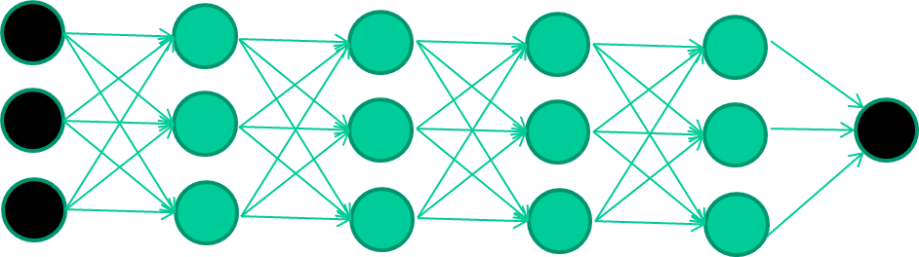
Deep Architecture

Slide 9
Deep Learning
Multilayer neural networks have been around for
25 years. What’s actually new?
We had good algorithms for learning the weights in networks with 1 or 2 hidden layer(s)
But these algorithms are not good at learning the weights for networks with more hidden layers

Slide 10


Slide 11
New way to train multi-layer NNs…

Slide 12
New way to train multi-layer NNs…
Train this layer first

Slide 13
New way to train multi-layer NNs…
Train this layer first
then this layer

Slide 14
New way to train multi-layer NNs…
Train this layer first
then this layer
then this layer

Slide 15
New way to train multi-layer NNs…
Train this layer first
then this layer
then this layer
then this layer

Slide 16
New way to train multi-layer NNs…
Train this layer first
then this layer
then this layer
then this layer
finally this layer

Slide 17
New way to train multi-layer NNs…
EACH of the (non-output) layers is trained to be an autoencoder
Basically, it is forced to learn good features that describe what comes from the previous layer

Slide 18














What is Deep Learning
Data
Feature extraction
Prediction model
Conventional Machine Learning pipeline
Deep prediction model
Data
Feature extraction
Feature learning
Prediction
Deep Learning

Slide 19
Disadvantages of Neural Networks
The number of trainable parameters becomes extremely large
Little or no invariance to shifting, scaling, and other forms of distortion
The topology of the input data is completely ignored

Slide 20
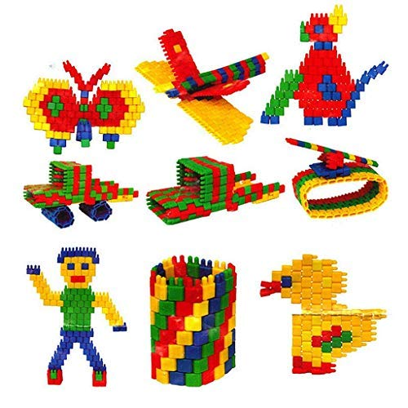
Building Blocks

Slide 21
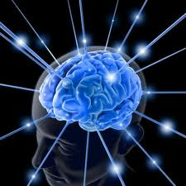
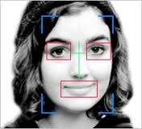
Learning by Composition? – A Face Recognition Analogy
Face or not ?
……
Lines, circles, squares
Brain Learning
Image pixels

Slide 22
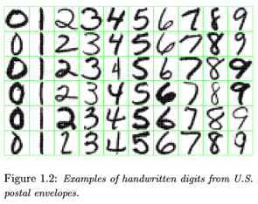
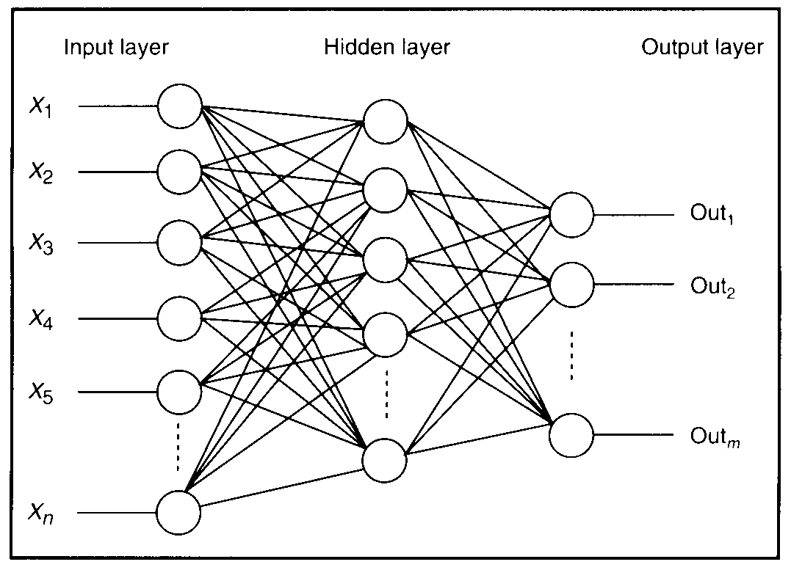
Feature detectors

Slide 23
vertical lines
1
63

Slide 24
Horizontal lines
1
63

Slide 25
Small circles
1
63

Slide 26
Small circles
1
But what about position invariance ???
our example unit detectors were tied to
specific parts of the image
63

Slide 27
Original Image
Horizontal Edge
Vertical Edge

Slide 28
Sobel Edges

Slide 29
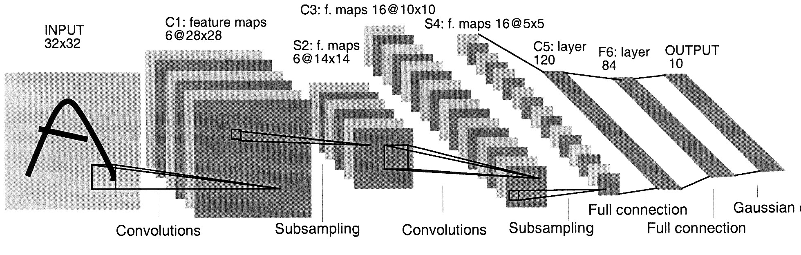
Convolutional Neural Network (CNN)
5 x 5 x 16
=(5-5)/1 +1 =1
=(16-16)/1 +1 =1

Slide 30
Convolution
These are the network parameters to be learned.
1 | -1 | -1
-1 | 1 | -1
-1 | -1 | 1
1 | 0 | 0 | 0 | 0 | 1
0 | 1 | 0 | 0 | 1 | 0
0 | 0 | 1 | 1 | 0 | 0
1 | 0 | 0 | 0 | 1 | 0
0 | 1 | 0 | 0 | 1 | 0
0 | 0 | 1 | 0 | 1 | 0
Filter 1
-1 | 1 | -1
-1 | 1 | -1
-1 | 1 | -1
Filter 2
……
6 x 6 image
Each filter detects a small pattern (3 x 3).

Slide 31
Convolution
1 | -1 | -1
-1 | 1 | -1
-1 | -1 | 1
Filter 1
stride=1
1 | 0 | 0 | 0 | 0 | 1
0 | 1 | 0 | 0 | 1 | 0
0 | 0 | 1 | 1 | 0 | 0
1 | 0 | 0 | 0 | 1 | 0
0 | 1 | 0 | 0 | 1 | 0
0 | 0 | 1 | 0 | 1 | 0
Dot
product
3
-1
6 x 6 image

Slide 32
Convolution
1 | -1 | -1
-1 | 1 | -1
-1 | -1 | 1
Filter 1
If stride=2
F(t) = max(0,t)= max(0,1)=1
1 | 0 | 0 | 0 | 0 | 1
0 | 1 | 0 | 0 | 1 | 0
0 | 0 | 1 | 1 | 0 | 0
1 | 0 | 0 | 0 | 1 | 0
0 | 1 | 0 | 0 | 1 | 0
0 | 0 | 1 | 0 | 1 | 0
3
-3
6 x 6 image

Slide 33
Convolution
1 | -1 | -1
-1 | 1 | -1
-1 | -1 | 1
Filter 1
stride=1
1 | 0 | 0 | 0 | 0 | 1
0 | 1 | 0 | 0 | 1 | 0
0 | 0 | 1 | 1 | 0 | 0
1 | 0 | 0 | 0 | 1 | 0
0 | 1 | 0 | 0 | 1 | 0
0 | 0 | 1 | 0 | 1 | 0
3
-1
-3
-1
-3
1
0
-3
-3
-3
0
1
3
-2
-2
-1
6 x 6 image

Slide 34
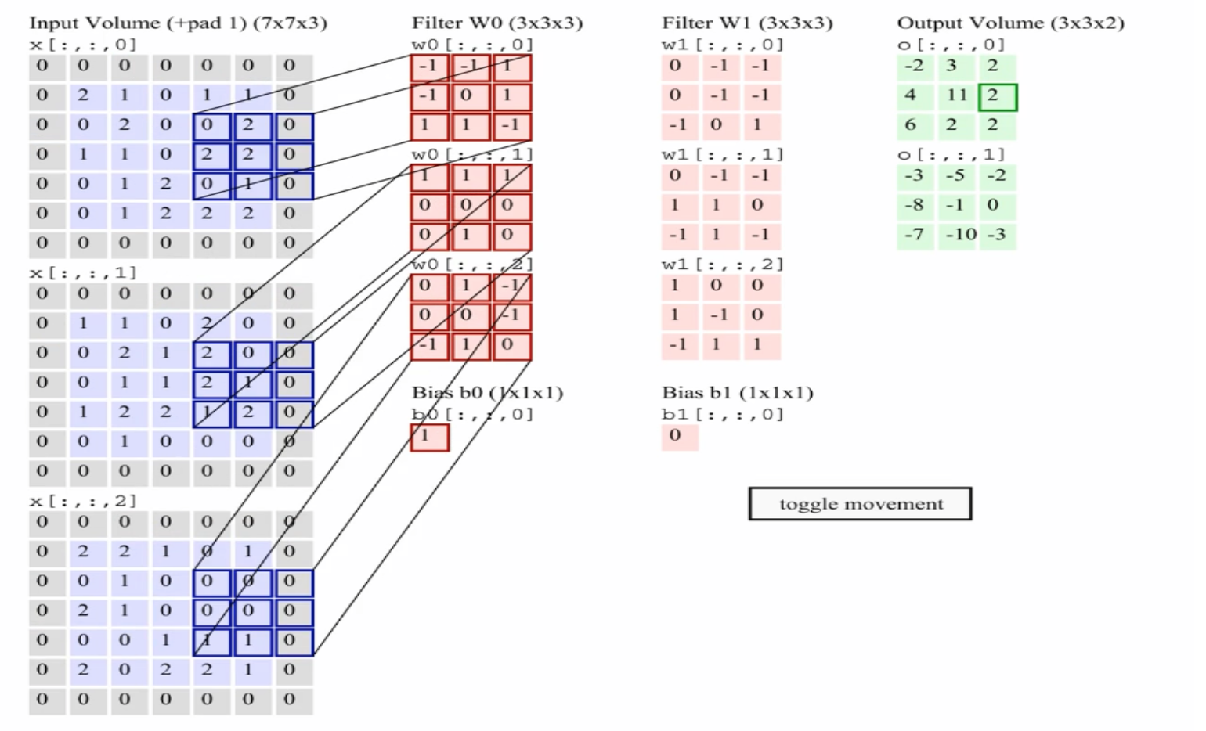
Multiple Convolutions
Animation: Andrej Karpathy http://cs231n.github.io/convolutional-networks/

Slide 35
Convolution
-1 | 1 | -1
-1 | 1 | -1
-1 | 1 | -1
Filter 2
stride=1
Repeat this for each filter
1 | 0 | 0 | 0 | 0 | 1
0 | 1 | 0 | 0 | 1 | 0
0 | 0 | 1 | 1 | 0 | 0
1 | 0 | 0 | 0 | 1 | 0
0 | 1 | 0 | 0 | 1 | 0
0 | 0 | 1 | 0 | 1 | 0
3
-1
-3
-1
-1
-1
-1
-1
-3
1
0
-3
-1
-1
-2
1
Feature
Map
-3
-3
0
1
-1
-1
-2
1
3
-2
-2
-1
6 x 6 image
-1
0
-4
3
Two 4 x 4 images
Forming 2 x 4 x 4 matrix

Slide 36
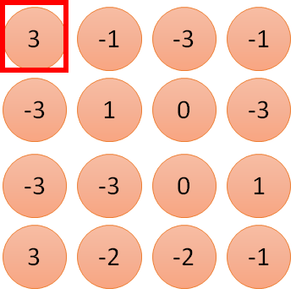
1 | -1 | -1
-1 | 1 | -1
-1 | -1 | 1
1
1
Filter 1
2
0
3
0
3
4:
0
1 | 0 | 0 | 0 | 0 | 1
0 | 1 | 0 | 0 | 1 | 0
0 | 0 | 1 | 1 | 0 | 0
1 | 0 | 0 | 0 | 1 | 0
0 | 1 | 0 | 0 | 1 | 0
0 | 0 | 1 | 0 | 1 | 0
…
0
8
1
9
0
10:
0
…
13
0
6 x 6 image
14
0
fewer parameters!
15
Only connect to 9 inputs, not fully connected
1
16
1
…

Slide 37
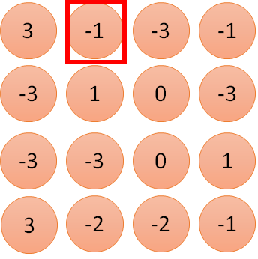
1 | -1 | -1
-1 | 1 | -1
-1 | -1 | 1
1:
1
Filter 1
2:
0
3:
0
3
4:
0
1 | 0 | 0 | 0 | 0 | 1
0 | 1 | 0 | 0 | 1 | 0
0 | 0 | 1 | 1 | 0 | 0
1 | 0 | 0 | 0 | 1 | 0
0 | 1 | 0 | 0 | 1 | 0
0 | 0 | 1 | 0 | 1 | 0
…
7:
0
8:
1
-1
9:
0
10:
0
…
13:
0
6 x 6 image
14:
0
Fewer parameters
15:
1
16:
1
Shared weights
Even fewer parameters
…

Slide 38
Convolutions: More detail
N
 |  |  | F
 | F
Output size: (N - F) / stride + 1
e.g. N = 6, F = 3:
stride 1 => (6 - 3)/1 + 1 = 4
stride 2 => (6 - 3)/2 + 1 = 2.5

Slide 39
Convolutions: More detail
In practice: Common to zero pad the border
0 | 0 | 0 | 0 | 0 | 0 | 0 | 0 | 0
0 |  |  |  |  |  |  |  | 0
0 |  |  |  |  |  |  |  | 0
0 |  |  |  |  |  |  |  | 0
0 |  |  |  |  |  |  |  | 0
0 |  |  |  |  |  |  |  | 0
0 |  |  |  |  |  |  |  | 0
0 |  |  |  |  |  |  |  | 0
0 | 0 | 0 | 0 | 0 | 0 | 0 | 0 | 0
Output size: (W−F+2P)/S +1
Input volume: 32x32x3
10 5x5 filters with stride 1, pad 2 Output volume size:
(32+2*2-5)/1+1 = 32 spatially,
so 32x32x10

Slide 40
Convolutions: More detail
In practice: Common to zero pad the border
0 | 0 | 0 | 0 | 0 | 0 | 0 | 0 | 0
0 |  |  |  |  |  |  |  | 0
0 |  |  |  |  |  |  |  | 0
0 |  |  |  |  |  |  |  | 0
0 |  |  |  |  |  |  |  | 0
0 |  |  |  |  |  |  |  | 0
0 |  |  |  |  |  |  |  | 0
0 |  |  |  |  |  |  |  | 0
0 | 0 | 0 | 0 | 0 | 0 | 0 | 0 | 0
Output size: (W−F+2P)/S +1
Input volume: 32x32x3
10 5x5 filters with stride 1, pad 2
No. of parameters in this layer?
Each filter has 5*5*3 + 1 = 76 params => 76*10 = 760

Slide 41
Max Pooling
1 | -1 | -1
-1 | 1 | -1
-1 | -1 | 1
-1 | 1 | -1
-1 | 1 | -1
-1 | 1 | -1
Filter 1
Filter 2
3
-1
-3
-1
-1
-1
-1
-1
-3
1
0
-3
-1
-1
-2
1
-3
-3
0
1
-1
-1
-2
1
3
-2
-2
-1
-1
0
-4
3

Slide 42
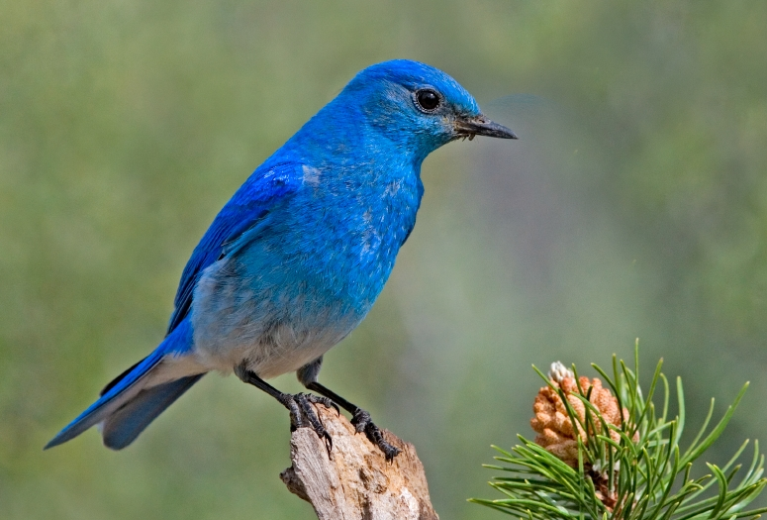

Why Pooling?
Subsampling pixels will not change the object
bird
bird
Subsampling
We can subsample the pixels to make image smaller
Fewer parameters to characterize the image

Slide 43
Why Pooling?
bird
bird
Subsampling
Invariance to small transformations
Larger receptive fields (neurons see more of input)

Slide 44
Pooling Layer
Insertion of pooling layer:
reduce the spatial size of the representation
reduce the amount of parameters and computation in the network, and hence also control overfitting.
The Pooling Layer operates independently on every depth slice of the input and resizes it spatially, using the MAX operation.
The most common form is a pooling layer with filters of size 2x2 applied with a stride of 2 -- downsamples every depth slice in the input by 2 along both width and height,
The depth dimension remains unchanged.

Slide 45
General Pooling Layer
Other pooling functions:
Average pooling
L2- norm pooling

Slide 46
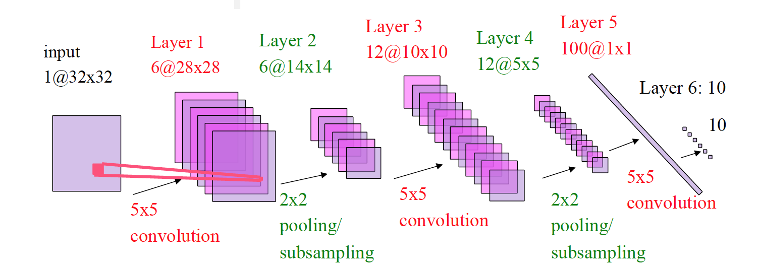
Convolutional Neural Network (CNN) [LeCun 1998]
=(25*6 +6) + (150*12+12) + (300*100+100) + (100*10+10)

Slide 47
A CNN compresses a fully connected network in two ways
Reducing number of connections
Shared weights on the edges
Max pooling further reduces the complexity

Slide 48
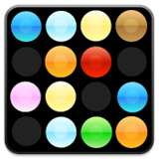
Going deep
object models
object parts
(combination
of edges)
edges
Training set: Aligned
images of faces.
pixels
[Honglak Lee]

Slide 49
Convolutional Neural Network (CNN)
Compared to standard feedforward neural networks with similarly-sized layers,
▪ CNNs have much fewer connections and parameters
▪ and so they are easier to train,
▪ while their theoretically-best performance is likely to be only slightly worse.

Slide 50
Problem of Fitting
Too many parameters = overfitting
Not enough parameters = underfitting
More data = less chance to overfit
How do we know what is required?

Slide 51
Regularization
Attempt to guide solution to not overfit
But still give freedom with many parameters

Slide 52
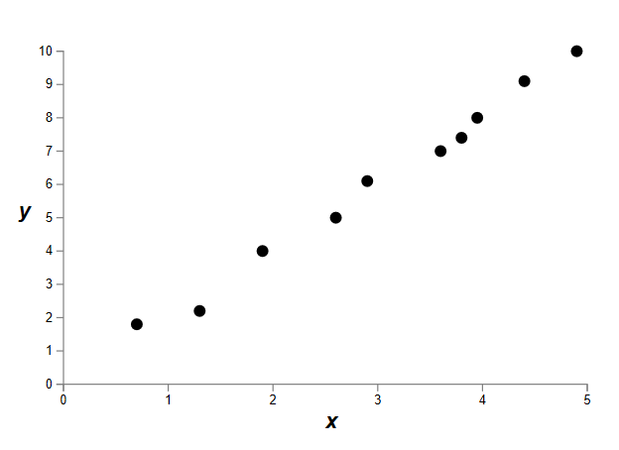
Data fitting problem

Slide 53
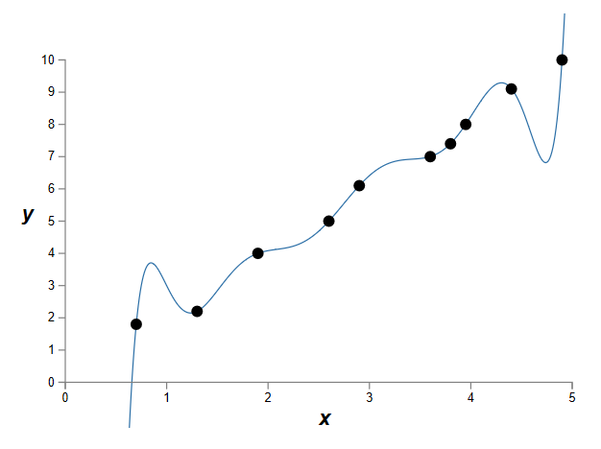
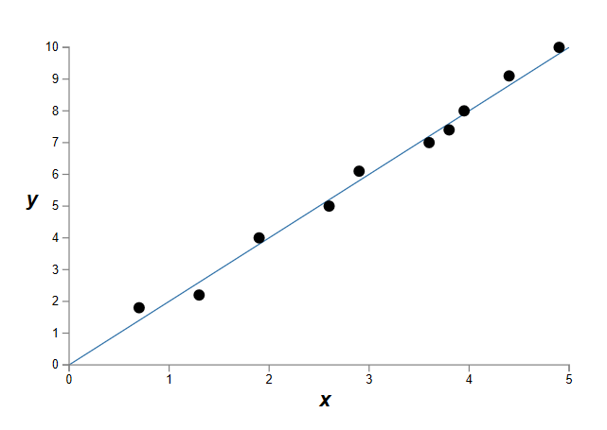
Which is better?
9th order polynomial
1st order polynomial
Notes:
How do we know a priori how many parameters we need?
Cross-validation is one way.

Slide 54
Regularization
Attempt to guide solution to not overfit
But still give freedom with many parameters
Idea: Penalize the use of parameters to prefer small weights.

Slide 55
CNN applications
Transfer learning
Fine-tuning the CNN
Keep some early layers
Early layers contain more generic features, edges, color blobs
Common to many visual tasks
Fine-tune the later layers
More specific to the details of the class
CNN as feature extractor
Remove the last fully connected layer
A kind of descriptor or CNN codes for the image
AlexNet gives a 4096 Dim descriptor
Notes:
http://cs231n.github.io/neural-networks-1/

Slide 56
Challenges
How to decide the number of hidden layers and nodes?
Choosing suitable deep learning architecture for a given data
Choosing suitable error and activation function

Slide 57
Challenges
Deep Learning from high volume of data
Deep Learning for high variety of data
Deep Learning with fast moving and steaming data
Scalability of the model
Distributed computing of data

Slide 58
References
Neural Networks for Pattern Recognition”, Bishop, C.M., 1996
Deep Belief Nets, 2007 NIPS tutorial , G . Hinton
Slides adapted from Andrew NG and G . Hinton
https://www.macs.hw.ac.uk/~dwcorne/
https://cs.uwaterloo.ca/~mli/
cs231n.stanford.edu/slides/2017/
Deep learning applications and challenges in big data analyticsMM Najafabadi, F Villanustre, TM Khoshgoftaar, N Seliya, R Wald, Journal of Big Data 2 (1), 1, 2015
Xue-Wen-Chen and Xiaotong Lin, “big data deep learning: challenges and perspectives”, IEEE, 2, 514-525, 2014
https://machinelearningmastery.com/inspirational-applications-deep-learning/
https://data-flair.training/blogs/applications-of-deep-learning-with-python/

Slide 59
Thanks

